Slide 1

Everything You Always Wanted to Know About Solar (But Were Afraid to Ask)
Rosana Francescato
Communications Director, MyDomino
8 June 2017

Slide 2

The solar journey

Slide 3
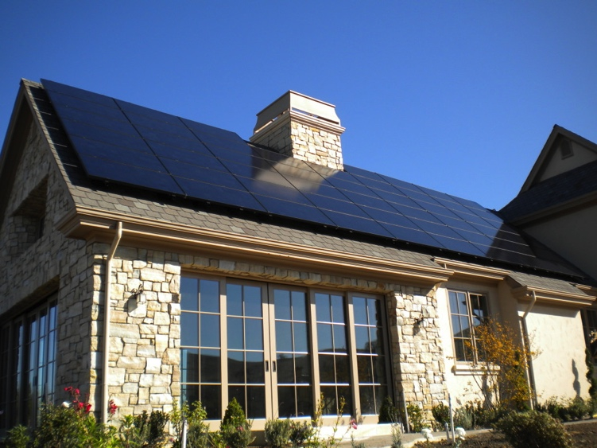
Home solar basics

Slide 4
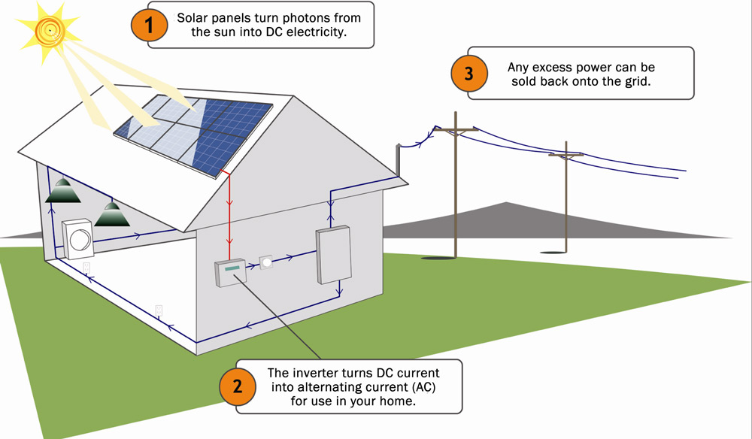
A simple technology!
Solar panels turn photons from the sun into DC electricity.
You can send excess power
you generate back to the grid.
The inverter turns DC energy
into AC energy for your home.

Slide 5

Solar prep
What to consider before going solar
Monthly electrical usage – average for 12 months
Roof condition and type
Near-term plans for home addition
or electric car
Financing: Cash, loan, lease/PPA

Slide 6
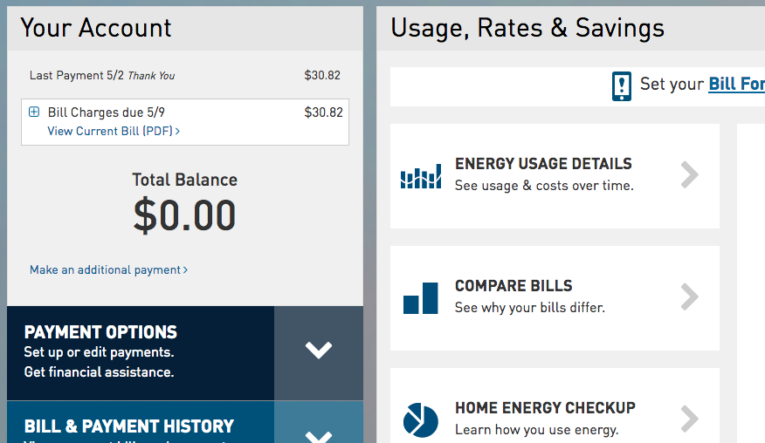

Electricity usage
Get your monthly electrical consumption for past 12 months.
Notes:
Click Green Button, specify date range, & download your data.

Slide 7
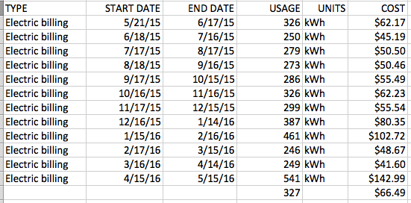
Electricity usage
Notes:
Click Green Button, specify date range, & download your data.

Slide 8
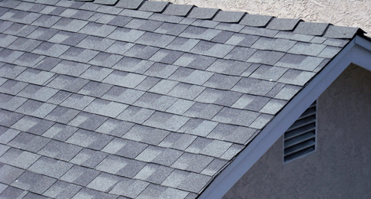
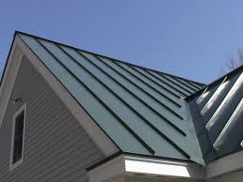
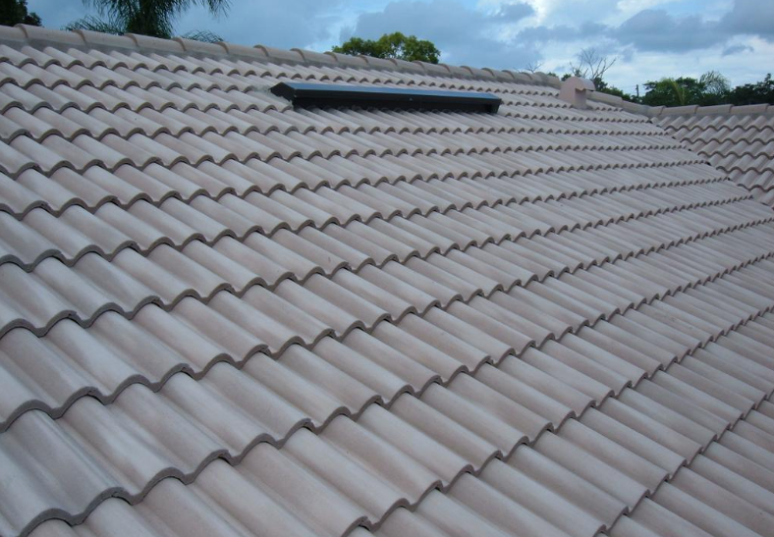
Roof type
May affect installation cost
  Compose shingle
  Tile (concrete, clay, slate)
  Wood shake
  Metal
  Flat
Composite shingle
Standing seam metal
Concrete Tile

Slide 9
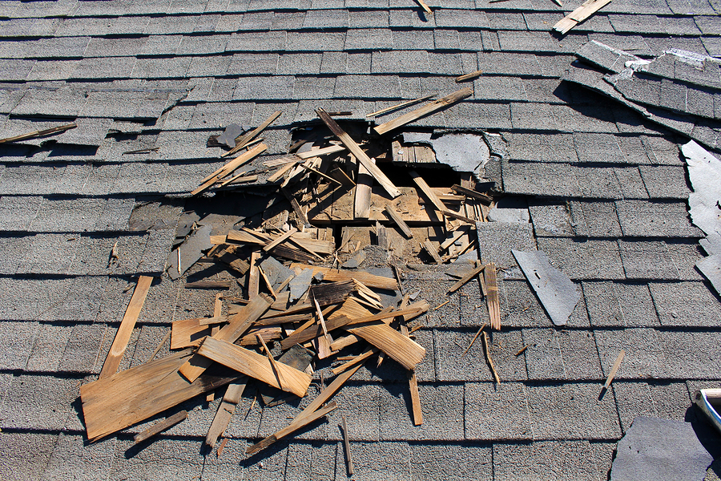
Roof condition
A solar system can last 25+ years
Your roof should have at least 5 - 7 years of useful life.
Your installer should check if your roof is in good condition.
Installer may request access to attic.

Slide 10
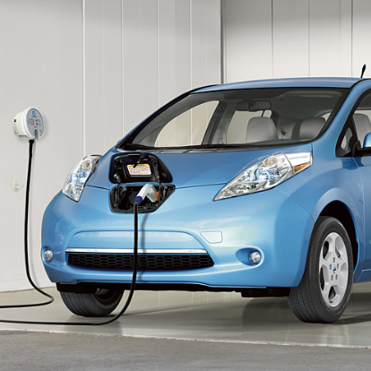
Near-term plans
Considering any of these?
Remodeling / addition to your home
New appliances
Hot tub
Electric car

Slide 11
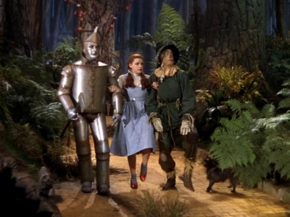
Financing options
Lease, PPA, or buy? Oh my!

Slide 12

Financing options
Ownership
Buy with cash or low-cost loan
System and power belong to you
Lease or PPA
Pay monthly
Lease: Pay a set monthly fee
Power purchase agreement (PPA):
Pay a monthly fee for the power you use

Slide 13
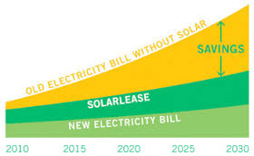
How do you pick?
Why own?
More savings – especially with cash purchase
Can take advantage of tax credits
Simplest, fastest way to finance your system
May be easier to sell home
Why lease?
Can go solar at no upfront cost
Can start saving on Day 1
May not have enough tax
liability for tax credit
Fewer maintenance worries

Slide 14
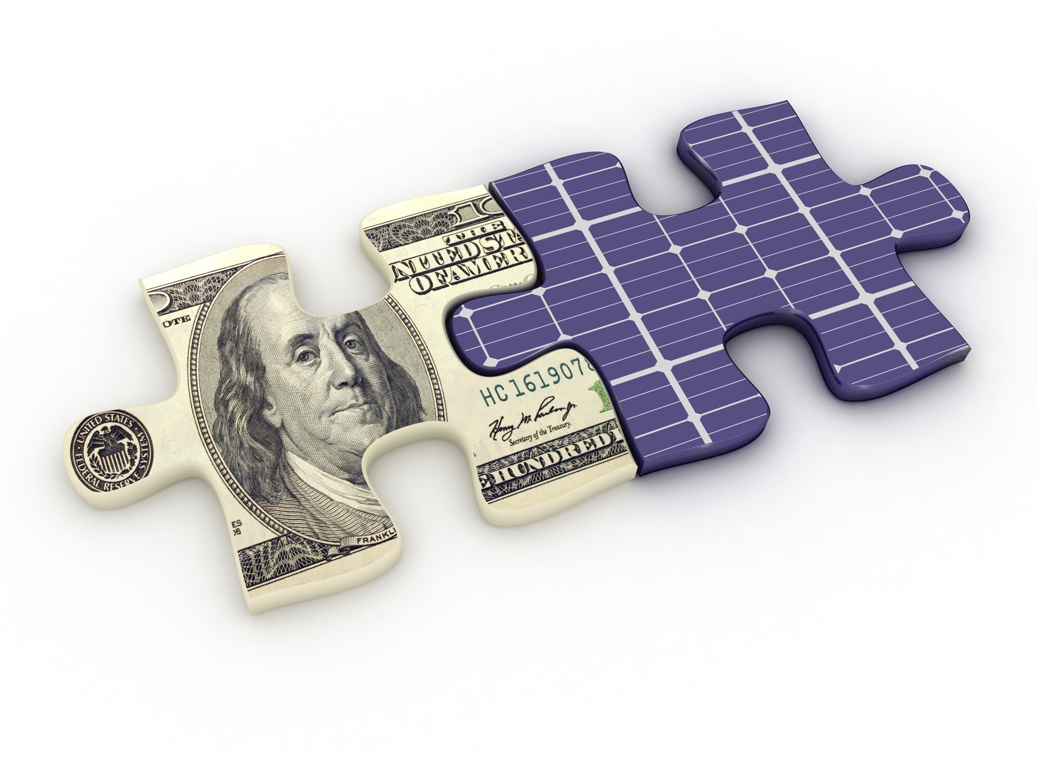
Financing options compared
Financing | Upfront cost | Monthly cost | 20-year savings | 30% tax credit | You own
Cash | $$$$ | 0 | $$$$ | ✔ | ✔
Loan | 0 | $$$ | $$$ | ✔ | ✔
Lease/PPA | 0 | $$ | $ |  | 

Slide 15
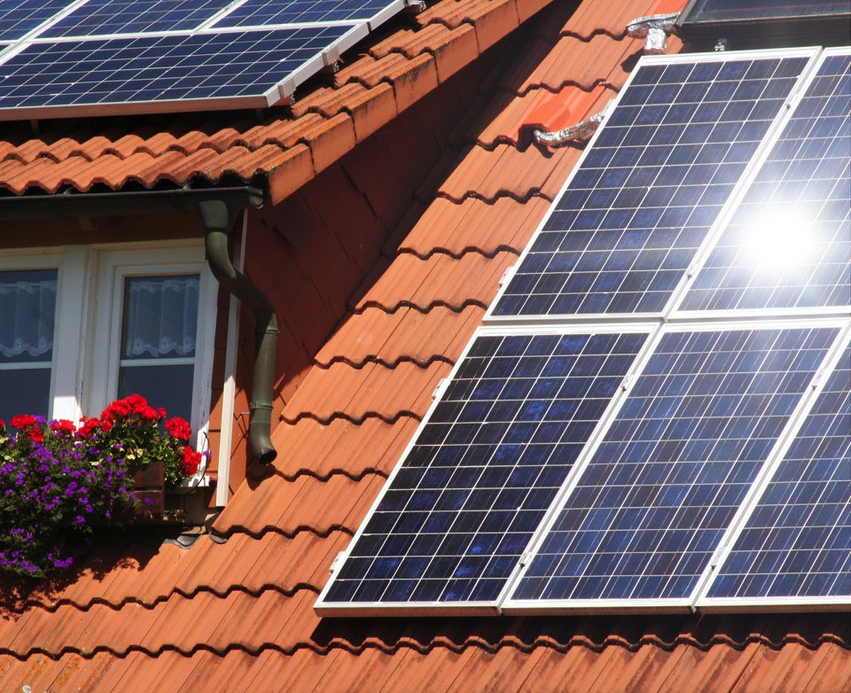
Process of going solar
First steps:
Find installers
Compare quotes
and equipment
Consider aesthetic preferences

Slide 16
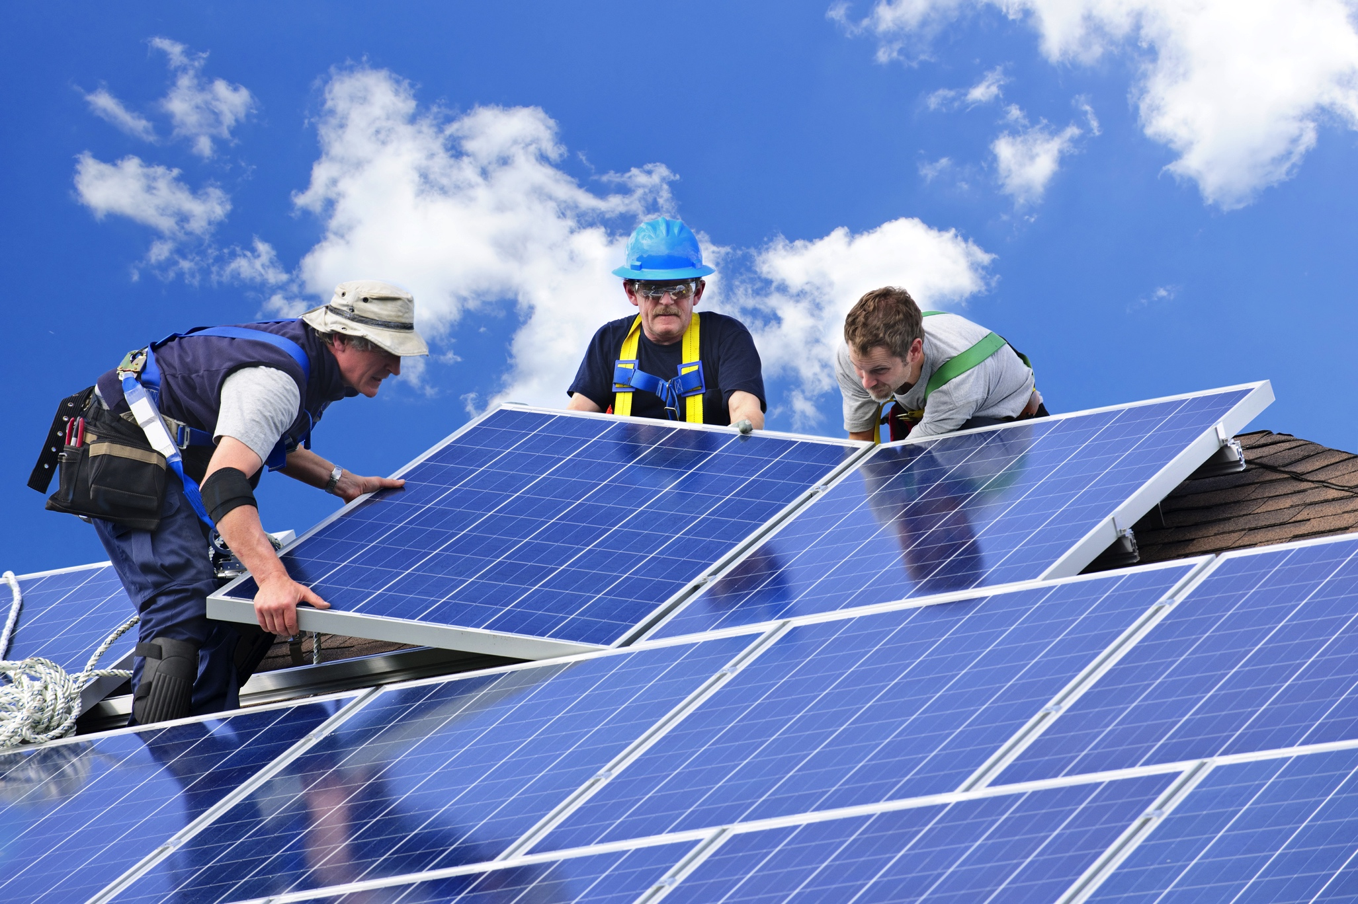
Find installers
Get references from friends, neighbors, and online sources like Yelp.
Check how long the company has been in business.
Pay attention to the vibe
you get from an installer.
Check out Sunible.com.

Slide 17

Compare quotes
Determine cash price
Compare dollars per watt
Example:
  Cash price: $17,000 before incentives
  System size: Twenty 250-watt panels
  = 5000-watt (5 kW) system
  $$ per watt: $17,000/5000
  = $3.40 per watt
Avg price in 2017:
$2.87 - $3.85 per watt

Slide 18
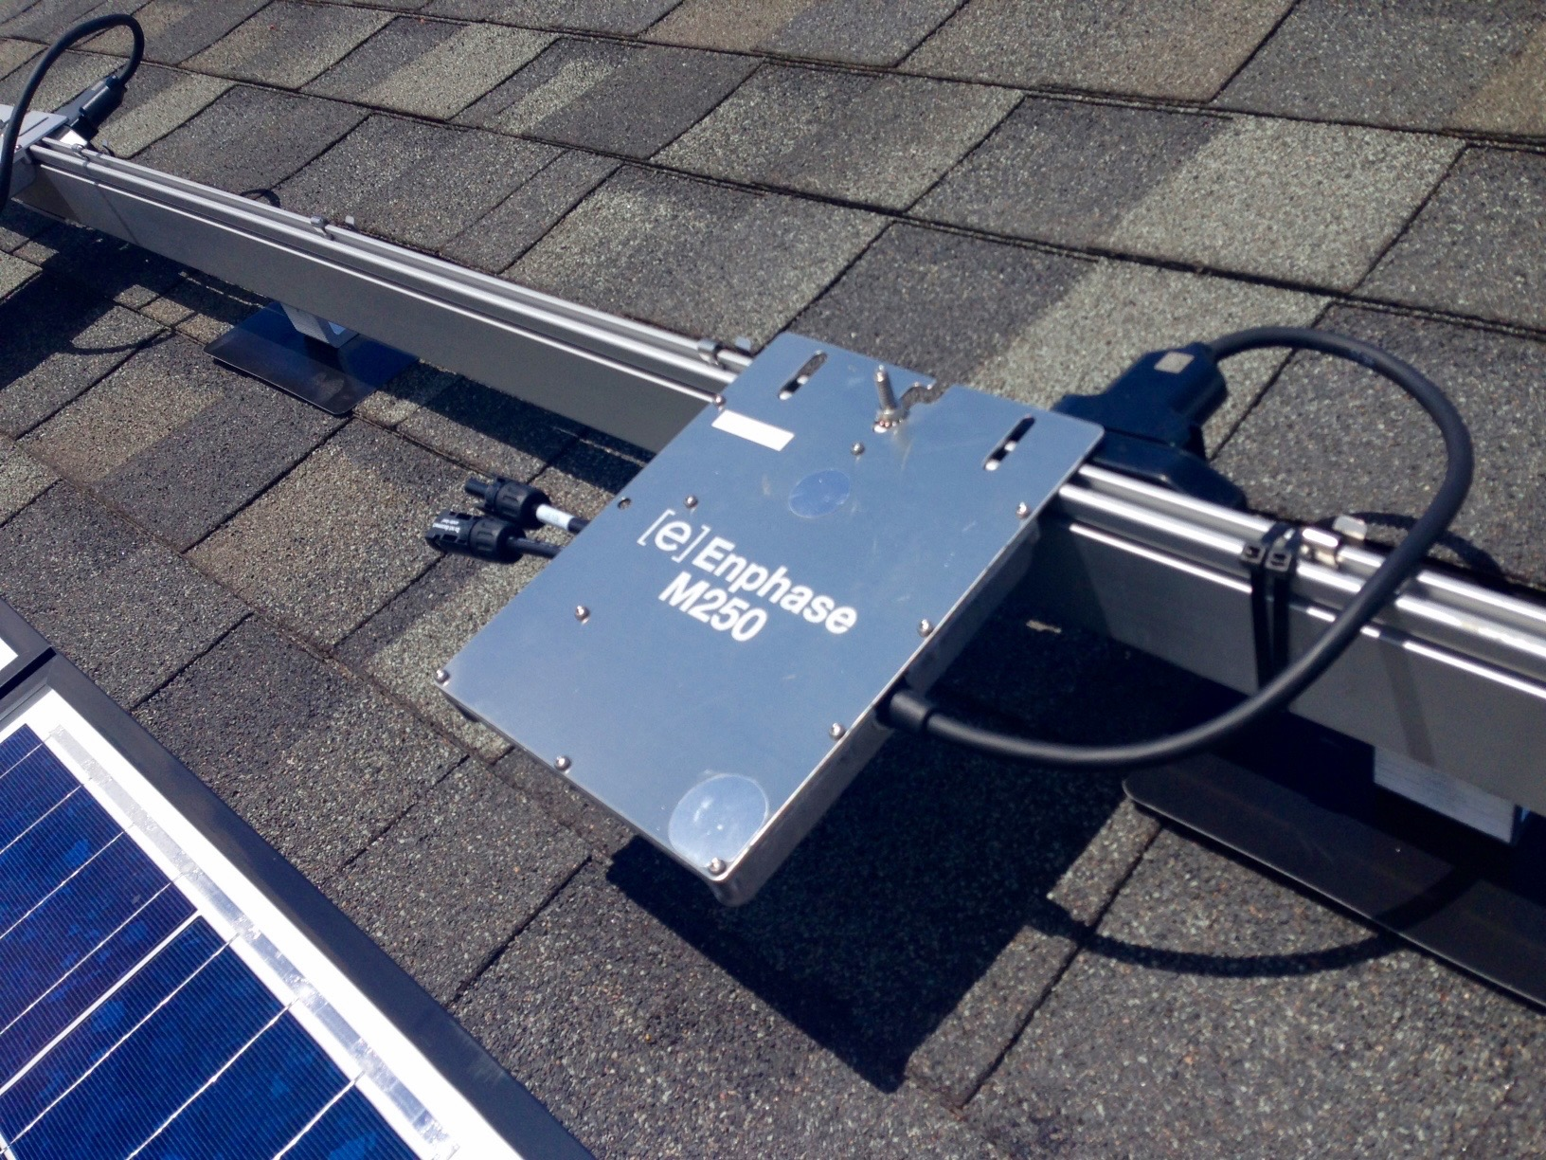
Compare equipment
Solar panels don’t vary that much.
Focus on the inverter.
  String inverters: Not as shade-tolerant -- best if your roof has full sun all day.
  Microinverters: Good option if you have any shading.
  Optimizers: A lot like microinverters, sometimes cheaper.
Compare the warranties for your
panels and inverters.

Slide 19
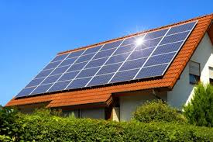
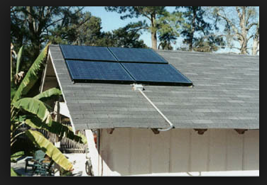
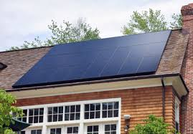
Aesthetic preferences
Ask your solar installer to
show you design plans.
Location of solar panels
Color of panels and frame
Location of conduit
Location of inverter
Silver frame
Example of not-so-great conduit run
Black frame

Slide 20
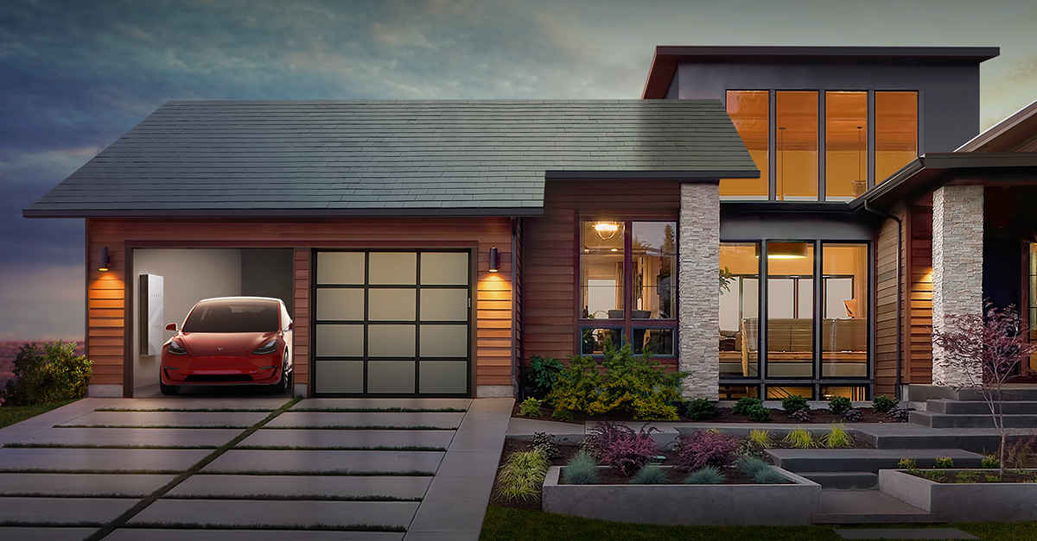
New solar roofs

Slide 21
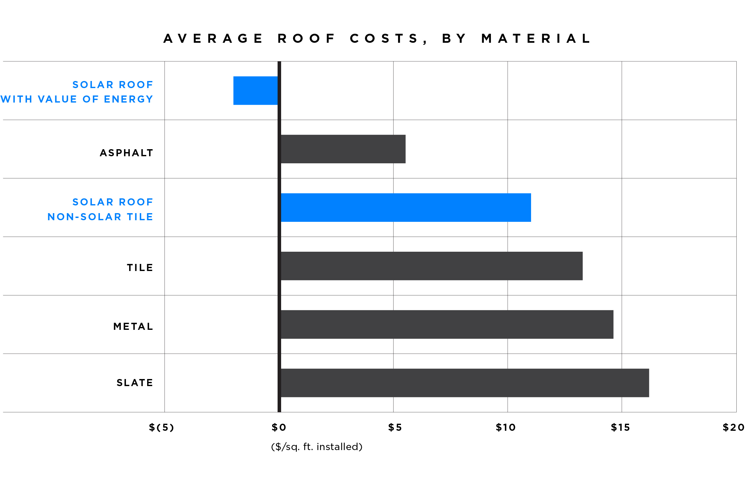
Aesthetic preferences
Upfront cost of solar tiles = ~$42/square foot

Slide 22

Final steps
Site visit
Sign papers
Permits
Installation
Inspection
Interconnection/
permission to operate

Slide 23
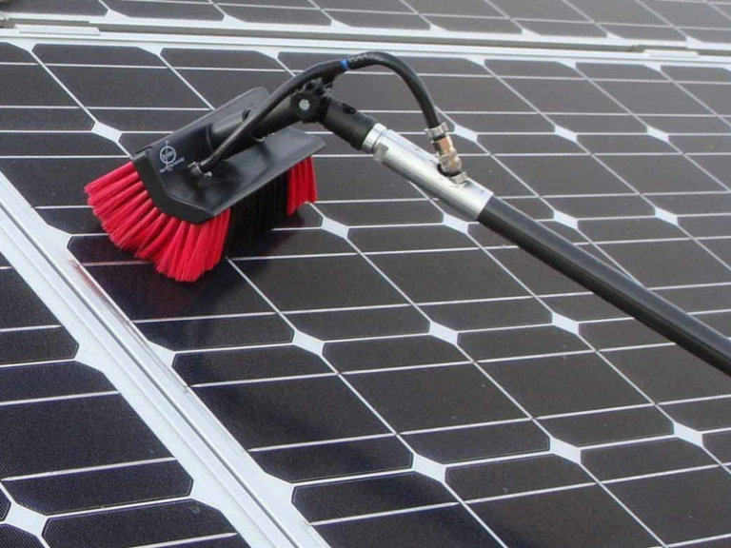
Maintenance and monitoring
How much maintenance will you need?
Washing
Production monitoring
Consumption monitoring

Slide 24
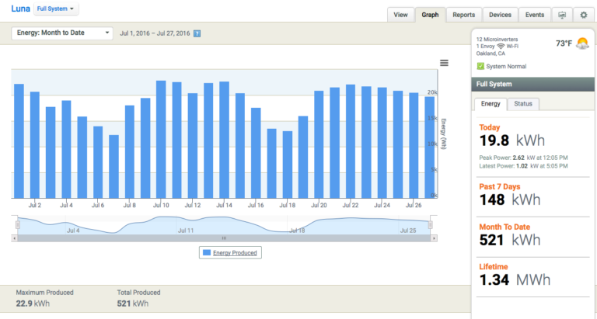
Monitoring

Slide 25
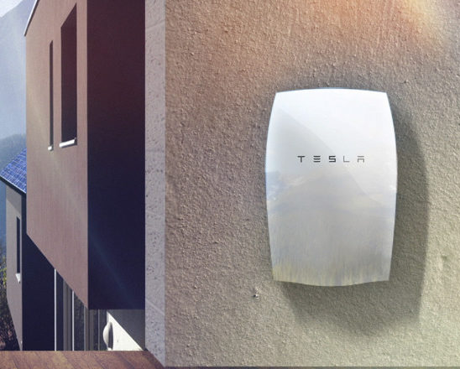
Battery backup
When does it make sense?
Net metering credit is not good
Net metering is not offered in your area
History of blackouts in your area
No access to utilities
(off-grid)
CA SGIP

Slide 26
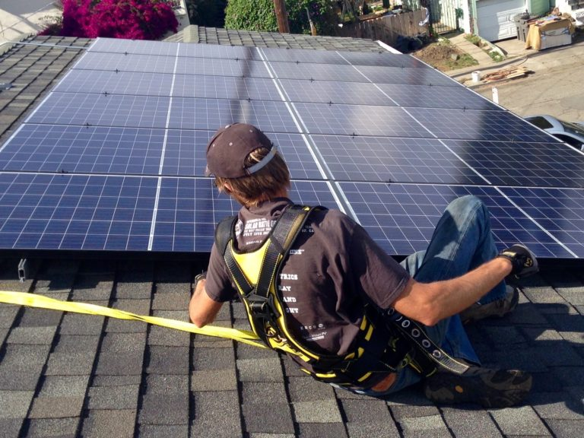

Know your options
You can go solar if your bill is low
SunWork: If your
average electric bill is $100 or lower

Slide 27
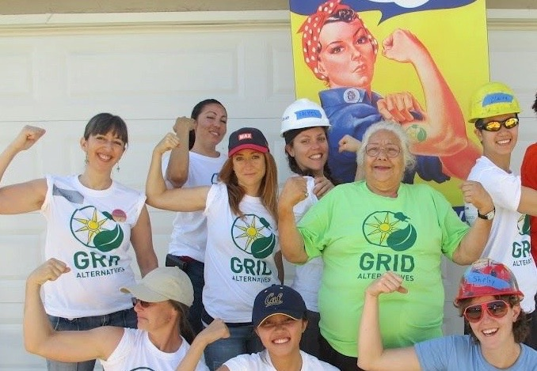

Know your options
You can go solar if your income is low
GRID Alternatives: If you qualify as low-income

Slide 28
Community Choice energy
Lets your community choose where to get its power
Who does what | Investor-Owned Utility | Community Choice Energy | Publicly Owned Utility
Procures power, sets rates | Utility | Community energy authority | Government
Owns and maintains transmission lines | Utility | Utility | Government
Handles billing and customer service | Utility | Utility | Government
Coming to Alameda County next year!

Slide 29
It’s a good time to go solar!
Solar is a simple technology!
Price has plummeted in recent years.
You can go solar even if
your bill or income is low.
Community Choice energy
will help our community
use more clean energy.

Slide 30
Contact info
Rosana Francescato
Communications Director, MyDomino
Contact me: rosana@mydomino.com
Check us out at: www.mydomino.com
Donate to my Solarthon fund:
https://donate.gridalternatives.org/rosana

Slide 31

Some little-known facts
about solar

